Slide 1

Topic Modelling with BERT
Instructor: Xandra Dave Cochran
April 3-10, 2024
Centre for Data, Culture & Society

Slide 2
Topic Modelling:
Unsupervised Machine Learning

Slide 3
Topic Modelling:
Unsupervised Machine Learning
Identifies clusters of related words in text

Slide 4
Topic Modelling:
Unsupervised Machine Learning
Identifies clusters of related words in text
Does not require predefined categories – good for discovery and exploration of a dataset

Slide 5
Introductions!
What is your previous experience with machine learning? Why are you interested in topic modelling? Have you used LLMs before? Is there a dataset you have in mind to use for topic modelling in future?

Slide 6
BERTopic
Problem: we have more data than we know what to do with! (nice problem to have)

Slide 7
BERTopic
Problem: we have more data than we know what to do with! (nice problem to have)
Processing large datasets by hand is very time-consuming

Slide 8
BERTopic
Problem: we have more data than we know what to do with! (nice problem to have)
Processing large datasets by hand is very time-consuming
Modern Large Language Models (LLMs) can help – advanced Neural Network models can process large bodies of text to infer meaning, sentiment, topic, etc

Slide 9
BERTopic
Problem: we have more data than we know what to do with! (nice problem to have)
Processing large datasets by hand is very time-consuming
Modern Large Language Models (LLMs) can help – advanced Neural Network models can process large bodies of text to infer meaning, sentiment, topic, etc
BERTopic uses state-of-the-art Transformer models to infer clusters of related words in a dataset, thereby identifying key topics

Slide 10
A little bit about transformer models
The neural network architecture behind the current AI book – ChatGPT, Dall-E, etc
Encoder-decoder
Positional encoding
Self-Attention

Slide 11
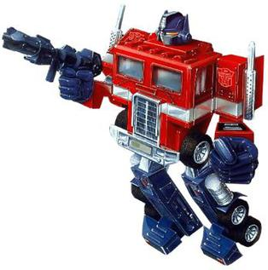
Transformers

Slide 12
Transformers
Wait, no

Slide 13
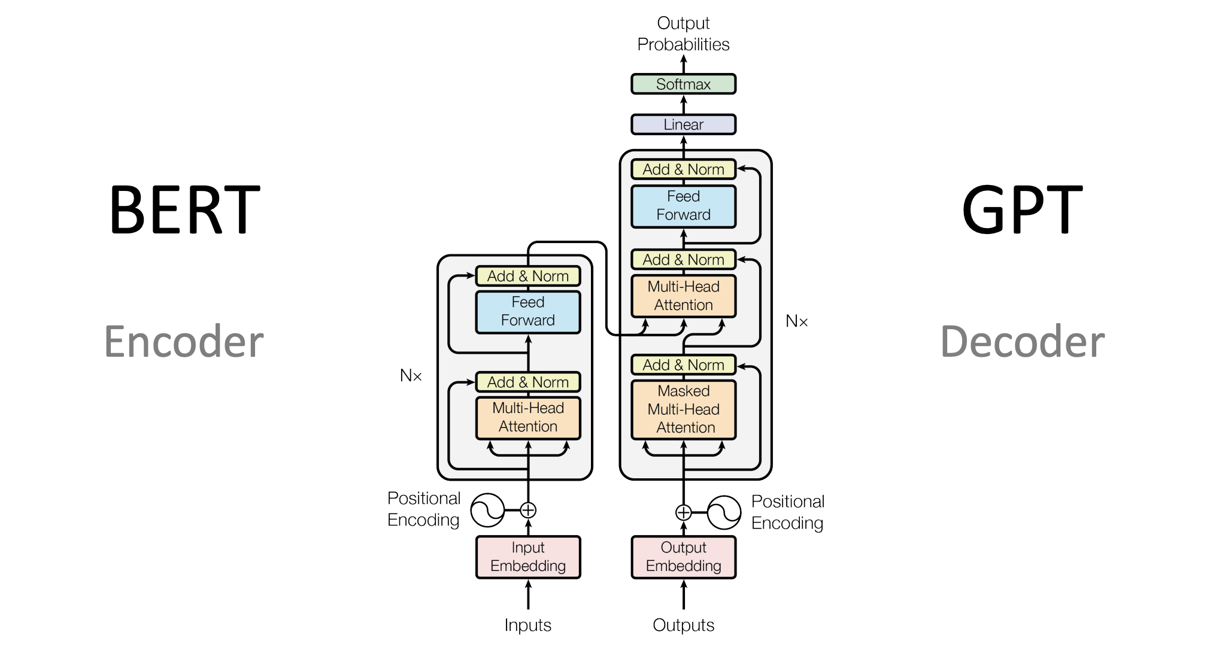
Transformers

Slide 14
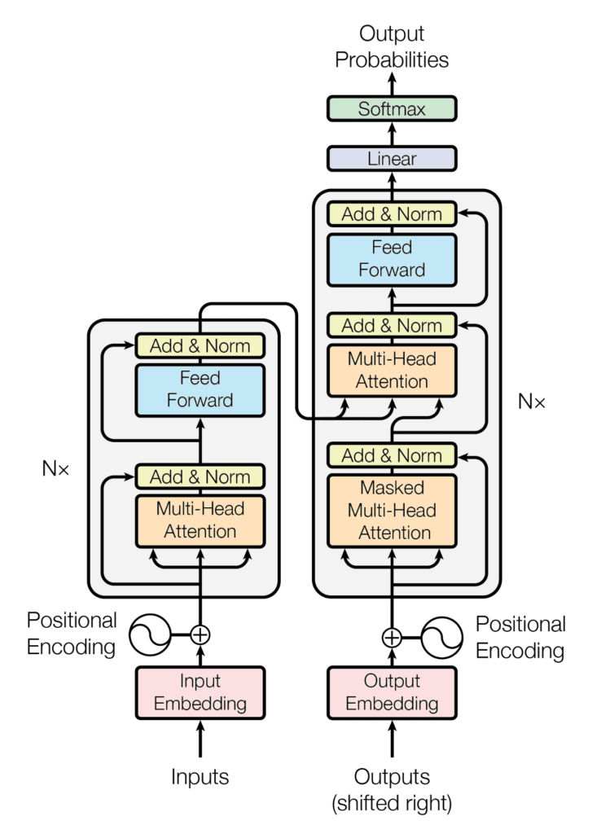
Transformers
Key insight – computers don’t understand text well, they understand large lists of numbers

Slide 15
Transformers
Key insight – computers don’t understand text well, they understand large lists of numbers
Almost everything in machine learning consists of turning a problem that makes sense to humans (but is very time consuming) into a gnarly mess of linear algebra that makes sense to computers, then converting it back to a human-interpretable form

Slide 16
Transformers
Key insight – computers don’t understand text well, they understand large lists of numbers
Almost everything in machine learning consists of turning a problem that makes sense to humans (but is very time consuming) into a gnarly mess of linear algebra that makes sense to computers, then converting it back to a human-interpretable form
As such, step 1 is input embedding

Slide 17
Embeddings
Each word (more accurately, token) is represented as a vector of numbers:
The = [7.3, -6.1, 8.0 ... -0.2, 3.2]
cat = [0.1, 3.2, -0.5 ... 3.7, -1.2]

Slide 18
Embeddings
Each word (more accurately, token) is represented as a vector of numbers:
The = [7.3, -6.1, 8.0 ... -0.2, 3.2]
cat = [0.1, 3.2, -0.5 ... 3.7, -1.2]
Seems random, but the idea is to train these embeddings to represent meaning as a high-dimensional space

Slide 19
Embeddings
Each word (more accurately, token) is represented as a vector of numbers:
The = [7.3, -6.1, 8.0 ... -0.2, 3.2]
cat = [0.1, 3.2, -0.5 ... 3.7, -1.2]
Seems random, but the idea is to train these embeddings to represent meaning as a high-dimensional space
This means semantically related words will be closer together than unrelated words – can be measured with cosine distance

Slide 20
Embeddings
Each word (more accurately, token) is represented as a vector of numbers:
The = [7.3, -6.1, 8.0 ... -0.2, 3.2]
cat = [0.1, 3.2, -0.5 ... 3.7, -1.2]
Seems random, but the idea is to train these embeddings to represent meaning as a high-dimensional space
This means semantically related words will be closer together than unrelated words – can be measured with cosine distance
Displacements in embedding space also have interesting properties, e.g.: (PUPPY – DOG) + CAT ≈ KITTEN

Slide 21
Token Embedding & Positional Encoding
Each token in a piece of text corresponds to a vector in semantic space

Slide 22
Token Embedding & Positional Encoding
Each token in a piece of text corresponds to a vector in semantic space
Combine this with another vector that represents the position of the word in the input – usually the output of a periodic function, e.g., a sum of multiple sine and cosine waves

Slide 23
Self-Attention
Calculate the vector product of each word in the input with all words in the input, sum and normalise the result

Slide 24
Self-Attention
Calculate the vector product of each word in the input with all words in the input, sum and normalise the result
Insight: words that are related (closer in semantic space) in the input will

Slide 25
Self-Attention
Calculate the vector product of each word in the input with all words in the input, sum and normalise the result
Insight: words that are related (closer in semantic space) in the input will
---be more influential on the result

Slide 26
Self-Attention
Calculate the vector product of each word in the input with all words in the input, sum and normalise the result
Insight: words that are related (closer in semantic space) in the input will
---be more influential on the result
---be more likely to be relevant to understanding the context of the focal word (e.g., the presence of ‘river’ disambiguates ‘bank’

Slide 27
Self-Attention
Calculate the vector product of each word in the input with all words in the input, sum and normalise the result
Insight: words that are related (closer in semantic space) in the input will
---be more influential on the result
---be more likely to be relevant to understanding the context of the focal word (e.g., the presence of ‘river’ disambiguates ‘bank’
---will act to shift the embedding of the original word to its specific meaning in context

Slide 28
Add & Norm
The output of attention is added to the original embedding vectors, and normalised so each vector sums to 1.0
The result is a reweighted version of the embedding which accounts for context

Slide 29
Feed Forward
Feed the result through a simple feed forward neural network
Add to original values and normalise again
repeat

Slide 30
BERTopic
This can be used to solve next-word problems (chat GPT), missing-word problems, and calculate embeddings for larger blocks of text (BERT)

Slide 31
BERTopic
This can be used to solve next-word problems (chat GPT), missing-word problems, and calculate embeddings for larger blocks of text (BERT)
In BERTopic, this is combined with a custom Term Frequency-Inverse Document Frequency model to induce clusters of related words, and this discover topics in a dataset

Slide 32
DEMO

Slide 33
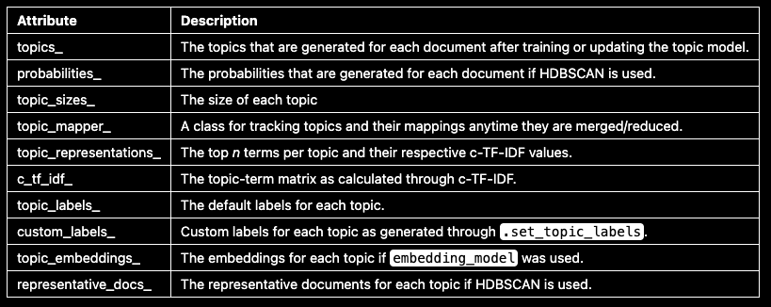
Attributes
There are a number of attributes that you can access after having trained your BERTopic model:

Slide 34
We can visualise
Topics
Topic Probabilities
Topic Hierarchies
Terms
Topic Similarity

Slide 35
DEMO

Slide 36
Also, we can…
Search topics
Reduce topics

Slide 37
DEMO

Slide 38
Thanks Everyone!
Next class: Wednesday 10th, 2-4PM
Please message me on Teams for office hours!
Reference: https://www.nltk.org/book/ch01.html

